Slide 1
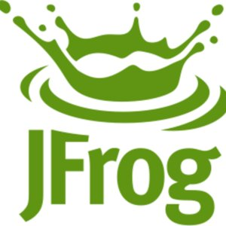

Groovy - getting started and practical
in hours*
*if you’re a good Java developer

Slide 2

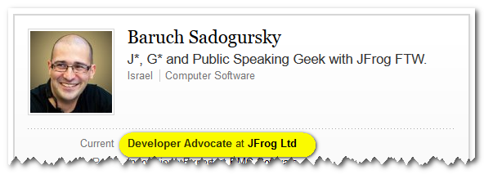
About your speaker
@jbaruch
github.com/jbaruch
linkd.in/jbaruch
stackoverflow.com/users/402053/jbaruch
Notes:
CURRENT – JB NEXT - YOAV

Slide 3

What Frog?

Slide 4

What Frog?

Slide 5

What Frog?

Slide 6
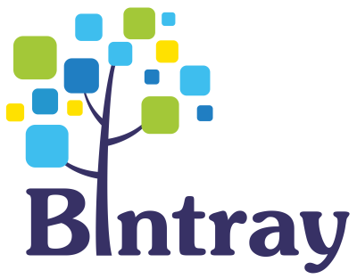
What Frog?
Notes:
Senior Front-End Developer
Senior Java Developer
DevOps Engineer
QA Engineer
2nd Level Support Engineer
Pre-sale Engineer

Slide 7

Why me and Groovy?

Slide 8
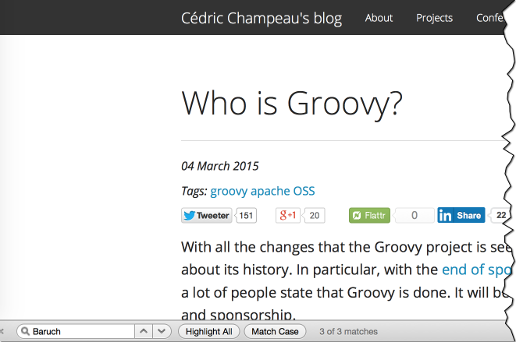
Why me and Groovy?

Slide 9
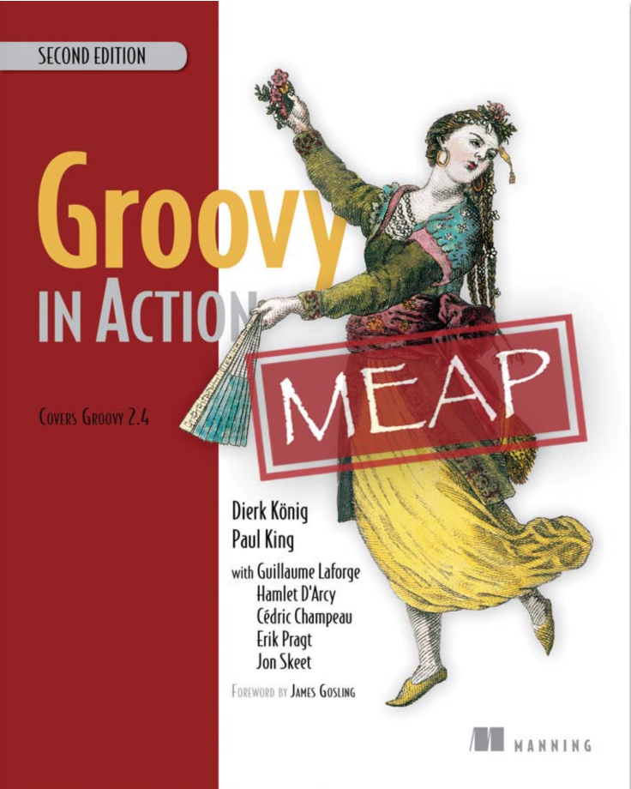
Just go read this book

Slide 10

No, thank you!

Slide 11
OK, but this talk is still TL;DR of it.

Slide 12
The Feel of Groovy
Teasers and essentials

Slide 13
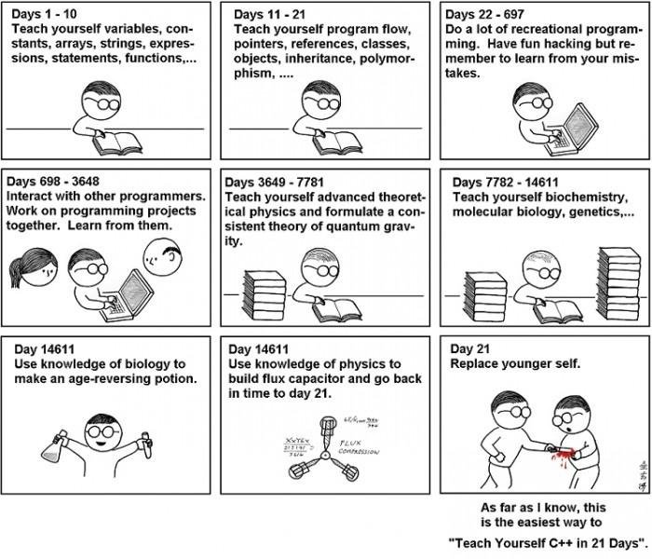

Slide 14
Not with Groovy

Slide 15

Java and Groovy – bros forever

Slide 16
Powerful as Scala, Java-friendly as… Java

Slide 17
Similar syntax
import java.util.*; // Java Date today = new Date(); // Java today = new Date() // Groovy require 'date' # Ruby today = Date.new # Ruby import java.util._ // Scala var today = new Date // Scala (import '(java.util Date)) ; Clojure (def today (new Date)) ; Clojure (def today (Date.)) ; Clojure alternative

Slide 18
Much more powerful

Slide 19
Teasers: Closures and IO
def number = 0 new File('data.txt').eachLine { line -> number++ println "$number: $line" }
Output:
1: first line
2: second line

Slide 20
Teasers: Collections and properties
def classes = [String, List, File] for (clazz in classes) { println clazz.package.name }
Output:
java.lang
java.util
java.io
Or even:
println([String, List, File].package.name)

Slide 21
XML gotta hurt. Or not.
Given:
<?xml version="1.0" ?>
<customers>
<corporate>
<customer name="Satya Nadella" company="Microsoft" />
<customer name="Tim Cook" company="Apple" />
<customer name="Larry Ellison" company="Oracle" />
</corporate>
<consumer>
<customer name="John Doe" />
<customer name="Jane Doe" />
</consumer>
</customers>

Slide 22
XML gotta hurt. Or not.
def customers = new XmlSlurper().parse(new File('customers.xml')) for (customer in customers.corporate.customer) { println "${customer.@name} works for ${customer.@company}" }
Output:
Satya Nadella works for Microsoft
Tim Cook works for Apple
Larry Ellison works for Oracle

Slide 23
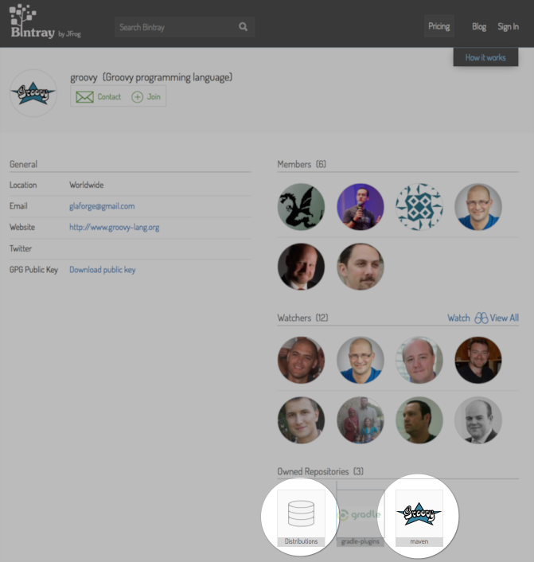

Slide 24
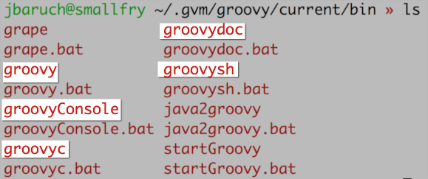
Groovy executables in dist

Slide 25
IDE support

Slide 26

IDE support

Slide 27
IDE support

Slide 28
IDE support

Slide 29
The basics
How the code looks like, with a dynamic touch

Slide 30
Looks like Java. Almost.
Anonymous inner classes (who needs them anyway)
Multiple variables initialization in for loop (when did you use them last time?)
Array creation with initialization (supported differently)
Java 8 syntax (not sure how lambda expressions should be treated)
Checked exceptions (we hate them too)
Try-with-resources (usually not needed)

Slide 31
Get rid of the boilerplate
Java:
java.net.URLEncoder.encode("a b", "UTF-8");
URLEncoder.encode 'a b' , 'UTF-8'
Groovy:

Slide 32
Default imports:
groovy.lang.*
groovy.util.*
java.lang.*
java.util.*
java.net.*
java.io.*
java.math.BigInteger
java.math.BigDecimal

Slide 33
Optional
return
Sometimes dots before method calls
Type declarations
Type casts
throws

Slide 34
Improvements over Java
def a = 5 def b = 9 assert b == a + a
Output:
Assertion failed:
assert b == a + a
| | | | |
9 | 5 | 5
| 10
false

Slide 35
Classes
class Course{
private String title
Course (String theTitle) { title = theTitle }
String getTitle(){ return title } }

Slide 36
Properties
class Course{ String title Course (String theTitle) { title = theTitle } }

Slide 37
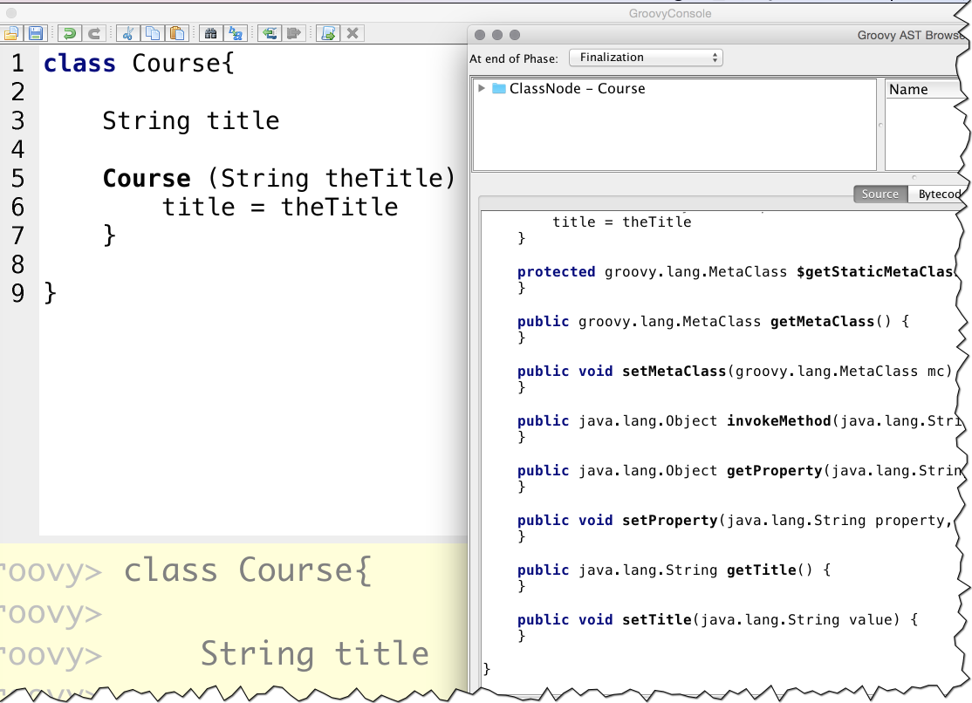

Slide 38
Scripts
Creates a class
Wraps top level script code in a main method
Existing methods become members
Existing classes used outside of the script

Slide 39
class Course { String title } Course groovy = new Course(title: 'Groovy') assert groovy.getTitle() == 'Groovy' assert getTitleBackwards(course) == 'yvoorG' String getTitleBackwards(course) { String title = course.getTitle() title.reverse() }

Slide 40
Annotations
Same concept, much more powerful usage
Can appear at unexpected places

Slide 41
AST Transformations
import groovy.transform.Immutable @Immutable class FixedCourse { String title } def groovy = new FixedCourse('Groovy') def grooovy = new FixedCourse(title: 'Groovy') assert groovy.title == 'Groovy' assert groovy == grooovy try { groovy.title = "Oops!" assert false, "should not reach here" } catch (ReadOnlyPropertyException expected) { println "Expected Error: '$expected.message'" }

Slide 42
AST Transformations
@ToString
@EqualsAndHashCode
@TupleConstructor
@Canonical
@Lazy
@IndexedProperty
@InheritConstructors

Slide 43
AST Transformations
@Delegate
@Singleton
@Immutable
Loggers
@Log
@Log4j
@Slf4j
@Commons

Slide 44
AST Transformations
@Synchronized
@WithReadLock
@WithWriteLock
Or just use GPars

Slide 45
AST Transformations
@AutoClone
Classic
Copy constructor
Serialization
@AutoExternalize
@PackageScope
@Category
@Mixin

Slide 46
Grapes: poor man’s dependency manager
@Grab('commons-lang:commons-lang:2.4') import org.apache.commons.lang.ClassUtils class Outer { class Inner {} } assert !ClassUtils.isInnerClass(Outer) assert ClassUtils.isInnerClass(Outer.Inner)

Slide 47
GString (SFW!)
def acronym = 'Gr8' def fullWord = 'Great' assert "$acronym stands for $fullWord" == 'Gr8 stands for Great'

Slide 48
Great support for regular expressions
No, I won’t show any examples here, we only have 75 minutes.

Slide 49
More object-oriented than Java
def x = 1 def y = 2 assert x + y == 3 assert x.plus(y) == 3 assert x instanceof Integer

Slide 50
How that happened?
Everything is an object
Operators are aliases for methods

Slide 51
Method aliases
Operator | Method | Already overloaded in
а + b | a.plus(b) | Number, String, StringBuffer, Collection, Map, Date, Duration
а[b] | a.getAt(b) | Object, List, Map, CharSequence, Matcher, and much more
a << b | a.leftShift(b) | Usually used as ‘append’ or ‘add’
switch(a){ case b: } a in b | b.isCase(a) | Object, Class, Range, Collection, Pattern, Closure; Any class can be used in switch
a == b | a.equals(b) | Yes, in Groovy == runs equals
a <=> b | a.compareTo(b) | java.lang.Comparable
a as type | a.asType(typeClass) | everywhere

Slide 52
Data Structures in Groovy
Powerful as List and Map, comfortable as Array

Slide 53
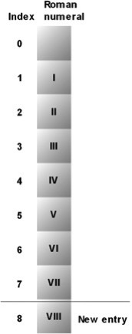
Lists
def roman = ['', 'I', 'II', 'III', 'IV', 'V', 'VI', 'VII'] assert roman[4] == 'IV' roman[8] = 'VIII' assert roman.size()

Slide 54
Maps
def http = [ 100: 'CONTINUE', 200: 'OK', 400: 'BAD REQUEST' ] assert http[200] == 'OK' http[500] = 'INTERNAL SERVER ERROR' assert http.size() == 4

Slide 55
Ranges
def x = 1..10 assert x.contains(5) assert !x.contains(15) assert x.size() == 10 assert x.from == 1 assert x.to == 10 assert x.reverse() == 10..1

Slide 56
closures
Hell of a feature

Slide 57
Closures

Slide 58
Why Closures?
Reference to block of code: Handlers, listeners, callbacks
Allows encapsulation of the control structures logic (WAT?)
Access to the enclosing scope
Not ugly

Slide 59
Anonymous inner classes, anyone?
Pass the logic without knowing it in advance
JButton.addActionListener(ActionListener a)
And then somewhere deep inside
a.actionPerformed(e)
Closures serve the same target (but better)
JButton.addActionListener(Closure c)
And then somewhere deep inside
c.call(e)

Slide 60

But it’s almost the same!

Slide 61
jbutton.addActionListener(new ActionListener() { @Override void actionPerformed(ActionEvent e) { //can’t do much except of playing with e } });
vs.
jbutton.addActionListener { Event e -> //can access whatever I want from the caller }

Slide 62

What just happened?!

Slide 63
Let’s take it easy
Closure is an object
Closure action = {println ‘groovy’}
We can declare a method that receives a closure
JButton#addActionListener(Closure action)
We can pass a closure as an argument for this method
jbutton.addActionListener(action)

Slide 64
We can skip the reference
jbutton.addActionListener({println ‘groovy’})
If closure is a last argiment it can be placed outside the parentheses
jbutton.addActionListener(){
println ‘groovy’
}
Parentheses are optional
jbutton.addActionListener{
println ‘groovy’
}

Slide 65
Cheater, addActionListener doesn’t accept Closure!
Closure can be cast to any type with corresponsding method
Closure c = {
ActionEvent e -> prinltn e
} as ActionListener

Slide 66

Looks exactly like SAMs in Java 8!

Slide 67
Closures vs. Java 8 Lambdas
Doesn’t have to backed up by SAM
Can be cast to any interface (not only SAM)
Can access any enclosing variables (not only final)
No parentheses, no semicolons!

Slide 68
Making sense of closures – who calls what

Slide 69
Control statements
Not your granddad’s ifs

Slide 70

Control statements, BTW
if (false) assert false if (null) { assert false } else { assert true }
def list = [0, 1, 2, 3] for (j in list) { assert j == list[j] }
list.each() { item -> assert item == list[item] }
def clinks = 0 for (remainingGuests in 0..9) { clinks += remainingGuests } assert clinks == (10 * 9) / 2
switch (3) { case 1: assert false; break case 3: assert true; break default: assert false }

Slide 71
Truth Power
Type | true
boolean | Well, true
Matcher | Match found
Collection, map | Not empty
String, GString | Not empty
Number | Not zero
Object reference | Not null
Everything | Whatever asBoolean method returns

Slide 72
Dynamic groovy
Or not

Slide 73
What “Dynamic” in Groovy means?
If Groovy compiles to Java classes, how can it be dynamic?
“Dynamic” in a way “can be any type”
“Dynamic” in a way method dispatch is not finalized

Slide 74
Optional Typing
Type declaration is optional
def means “any type”, means “java.lang.Object”
It behaves that way!
Two approaches:
Declare only when you have to
Don’t declare only when you have to

Slide 75
When you have to omit the type?
Type encapsulation
You actively don’t want to know
Because you want to treat it like something else
List customers = new XmlSlurper().parse(new File('customers.xml')) def customer = customers.first()

Slide 76

Treat like something else?
If I walk like a duck, swim like a duck, fly like a duck and quack like a duck, who cares I am an XML Node!
List customers = new XmlSlurper().parse(new File('customers.xml')) Customer customer = customers.first() as Customer

Slide 77
Dynamic method dispatch
This achieved by passing all the calls via Meta Object Protocol (MOP)
Decisions are taken in runtime
def customers = new XmlSlurper().parse(new File('customers.xml')) Customer customer = customers.first() as Customer customer.buy()

Slide 78
Keywords to google:
MetaClass and ExpandoMetaClass
methodMissing and propertyMissing
getMethod and getProperty

Slide 79
Problems with Dynamic
Bad assignments not enforces at compile time
Absence of methods and properties can’t fail compilation (e.g. typos not being caught)

Slide 80
Turning the magic off
Dynamic types can be turned off for better confidence
@TypeChecked
Dynamic method dispatch can be turned off for better performance (no MOP == Java performance)
@CompileStatic

Slide 81
What Gives?!
Still tons of syntactic sugar
Use dynamic stuff when needed
Builders, Slurpers, Grails, all the magic
Win-win!

Slide 82
Random things I love about Groovy
Private scope is broken
Unfortunately targeted to be “fixed” in 3.0
Methods can have default values
def print(String value, String encoding = ‘UTF-8’)
Generates overloaded methods in bytecode
with{} gets in context of the object

Slide 83
Random things I love about Groovy
Import alias
import com.somecompany.RobotDefaultImpl as Robot
Refer to method with String
Removes some limitations of Java literals
Allows dynamic method calls:
def “${name} can name a method with spaces”(){ }

Slide 84
What we didn’t cover ☹
Everything in depth
Builders and Slurpers
Testing (Spock and Geb)
Parallel programming with GPars (Hint: everything Scala has and more)
DSLs (Hint: Groovy is perfect for DSLs)
Writing AST transformations
Other projects in the ecosystem (Gradle, Grails, Ratpack, Griffon, Grooscipt, Lazybones…)

Slide 85
Just go read this book

Slide 86
No, thank you!

